Slide 1
Favorite Dishes App 1
Professor Jianqing (Fisher) Wu

Slide 2
Overview
Introduce the app framework
Decompose the app into pages
Create an app with two tabs
Use icons
Read data from .ts file
Add lists
Add Cards

Slide 3
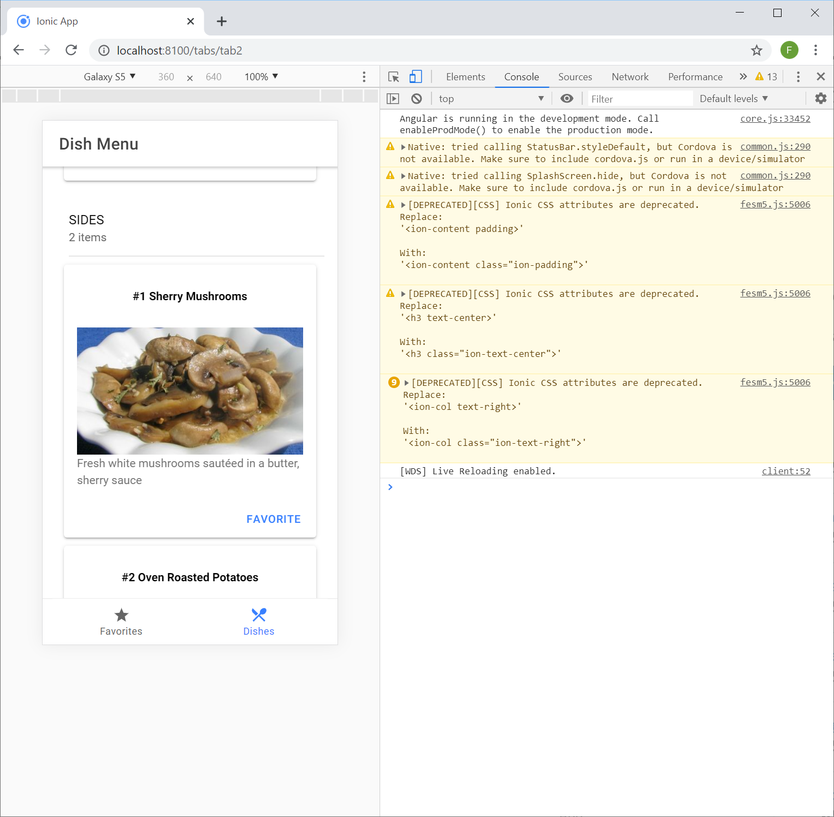
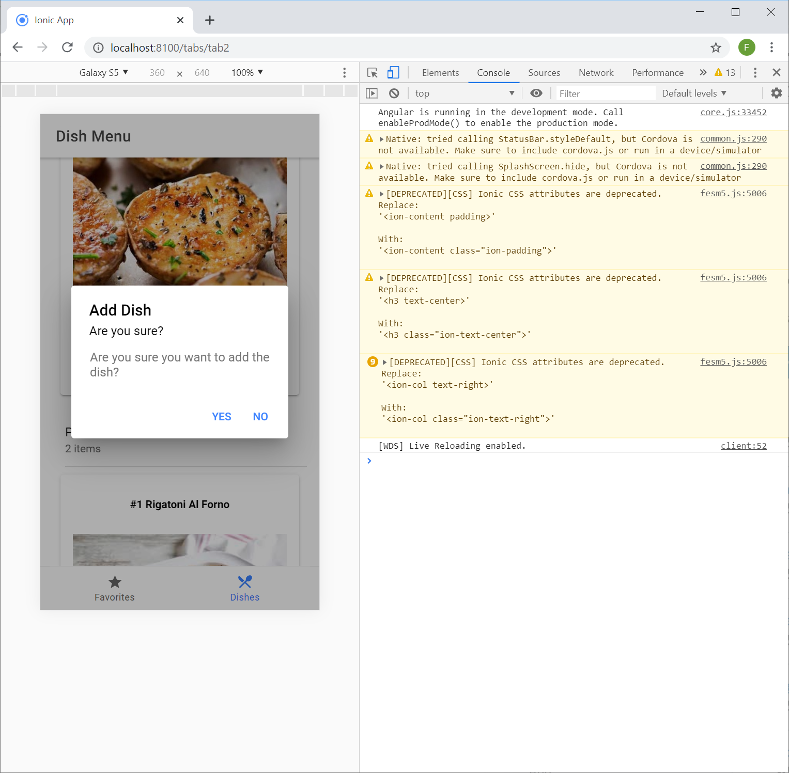
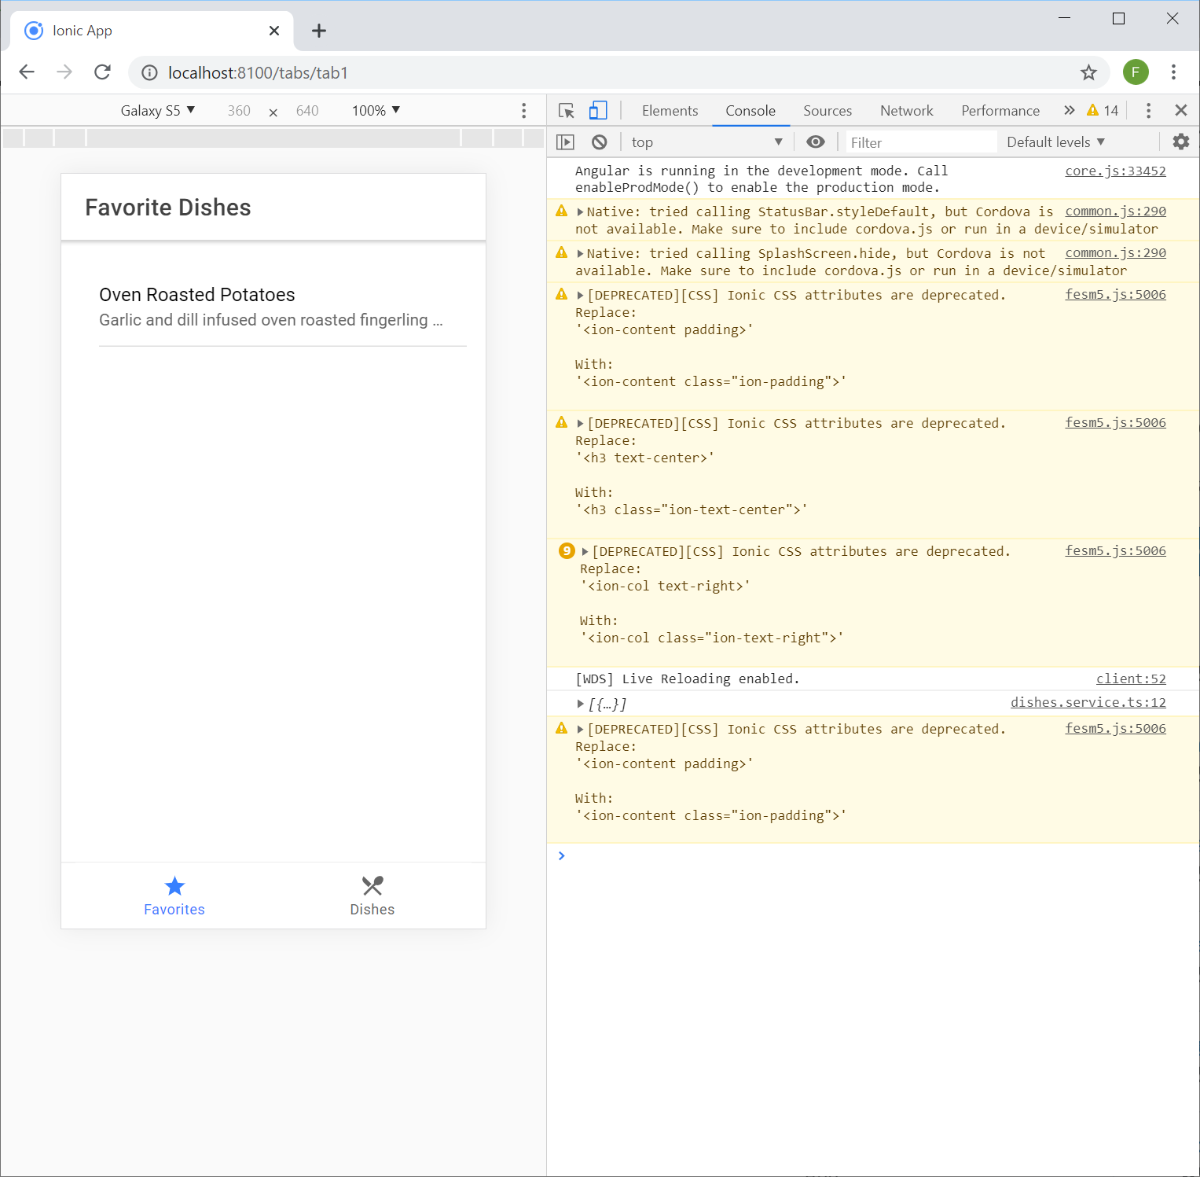
App Structure

Slide 4
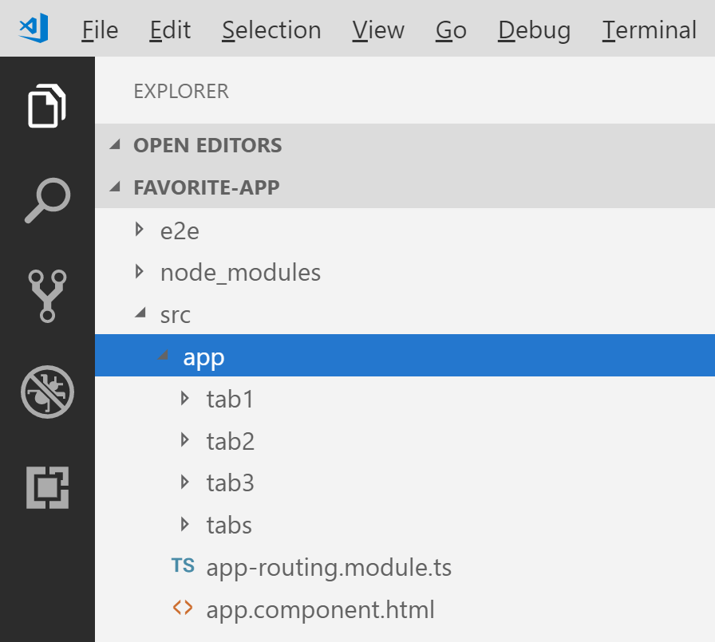
Create a New App with Tabs
Run “ionic start favorite-app tabs” command
Open “favorite-app” folder
Delete “tab3” folder

Slide 5
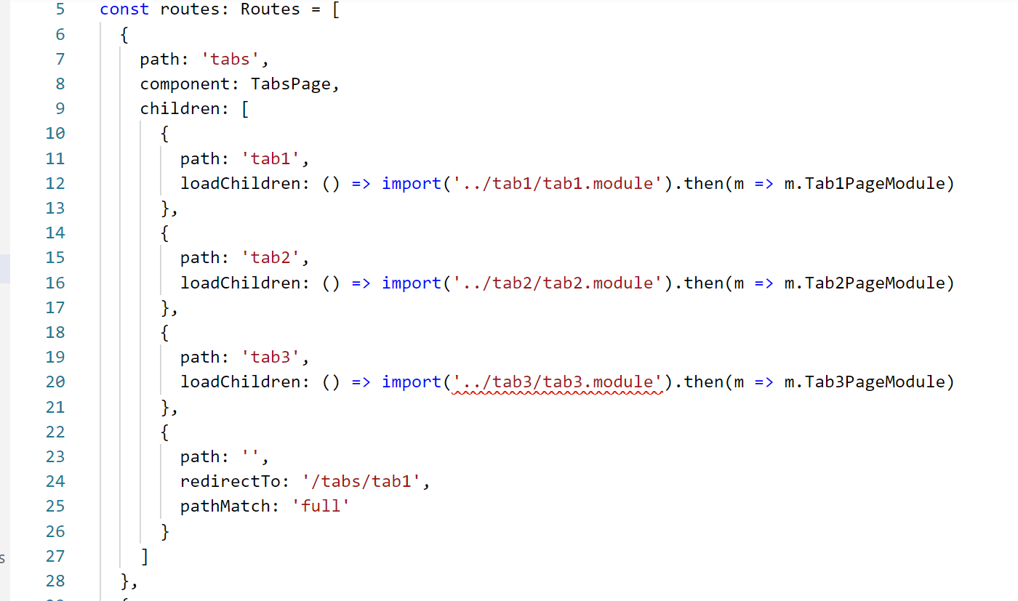
Remove “tab3”
Remove “tab3” codes in “tabs-routing.module.ts”

Slide 6
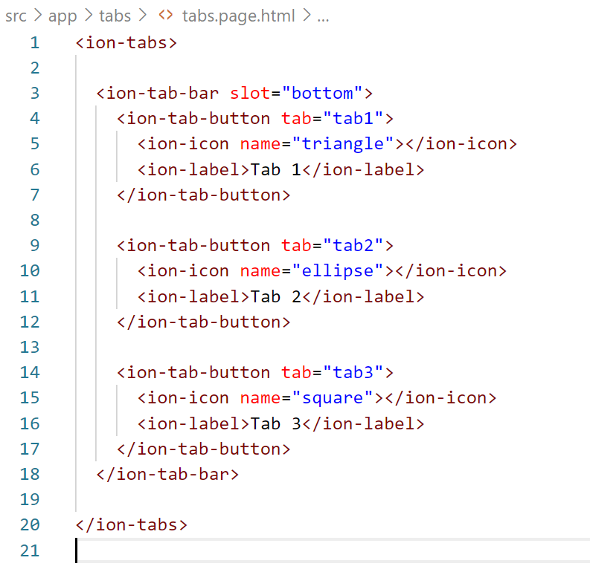
Remove “tab3”
Remove “tab3” codes in “tabs.page.html”

Slide 7
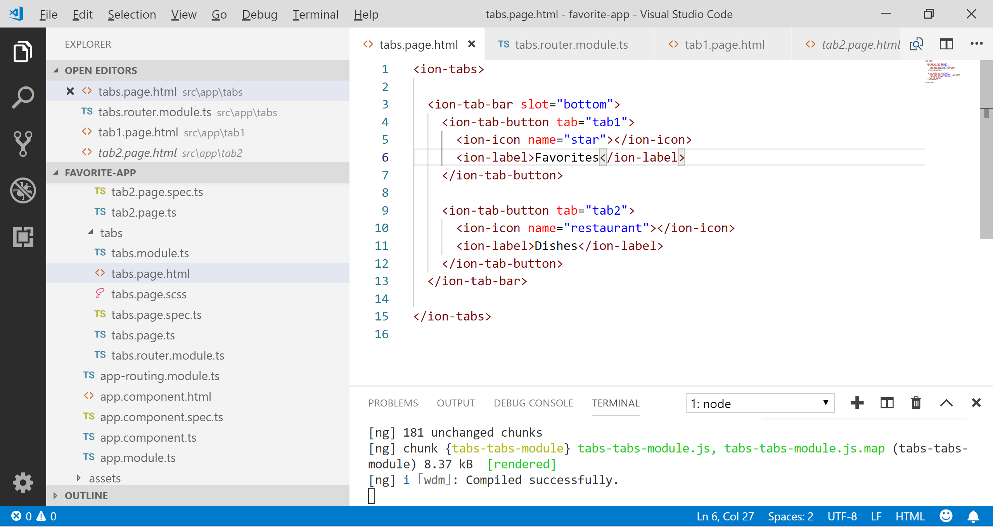
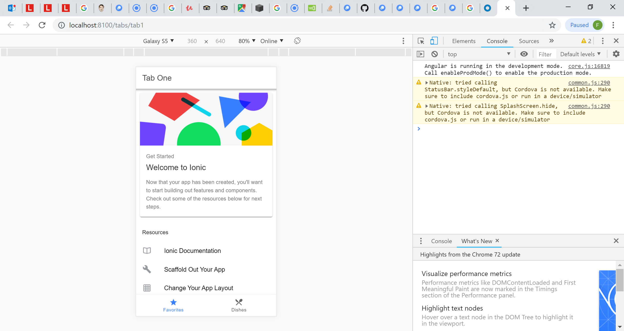
Change the Tab Bar
Change the icons and words in the tab bar by editing “tabs.page.html” file

Slide 8
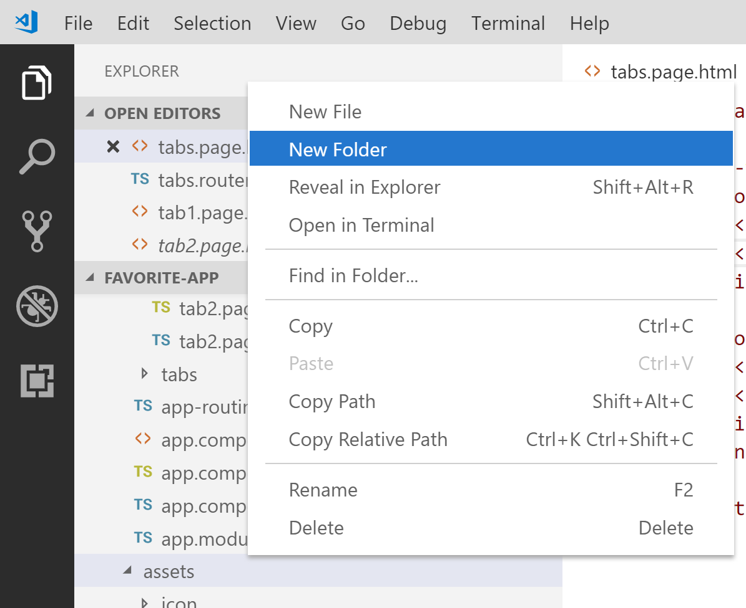
Bring in Dishes Data
Right click “assets” folder, then click “New Folder”. Name it “data”
Download “dishes.ts” file together with all the other image files from BeachBoard and put all these files under the “data” folder.

Slide 9
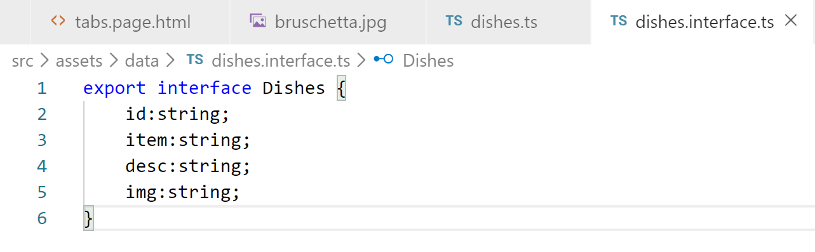
Create Interface for Dishes Data
Right click “data” folder, then click “New File”. Name it “dishes.interface.ts”. Add the following codes

Slide 10
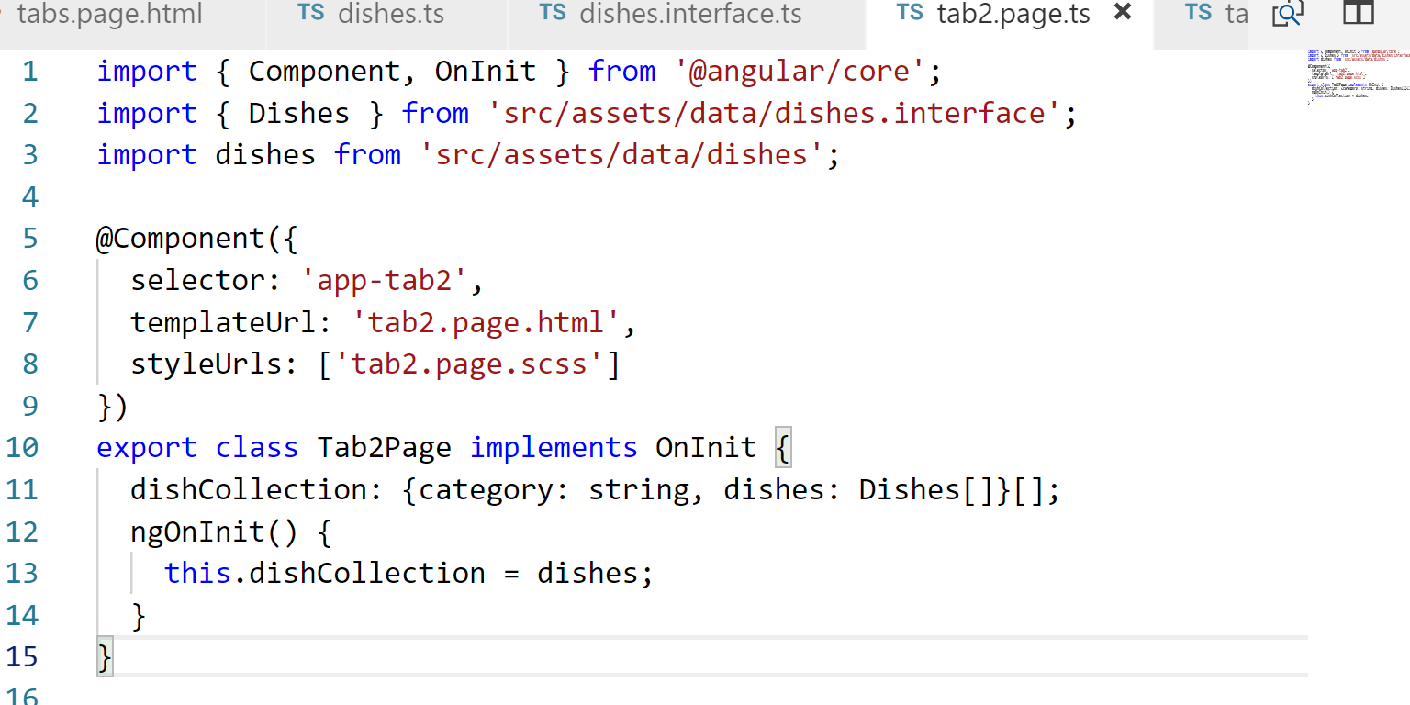
List Dish Categories on “tab2”
To get data from “data.ts” file, edit “tab2.page.ts” as follows

Slide 11
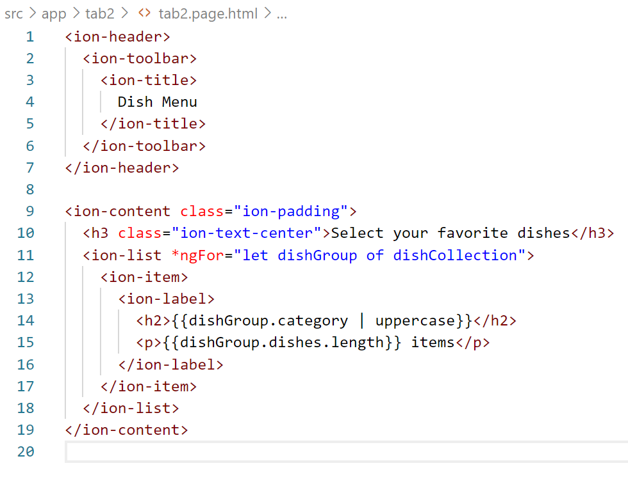
List Dish Categories on “tab2”
Edit “tab2.page.html” as follows, to add a list for dish categories

Slide 12
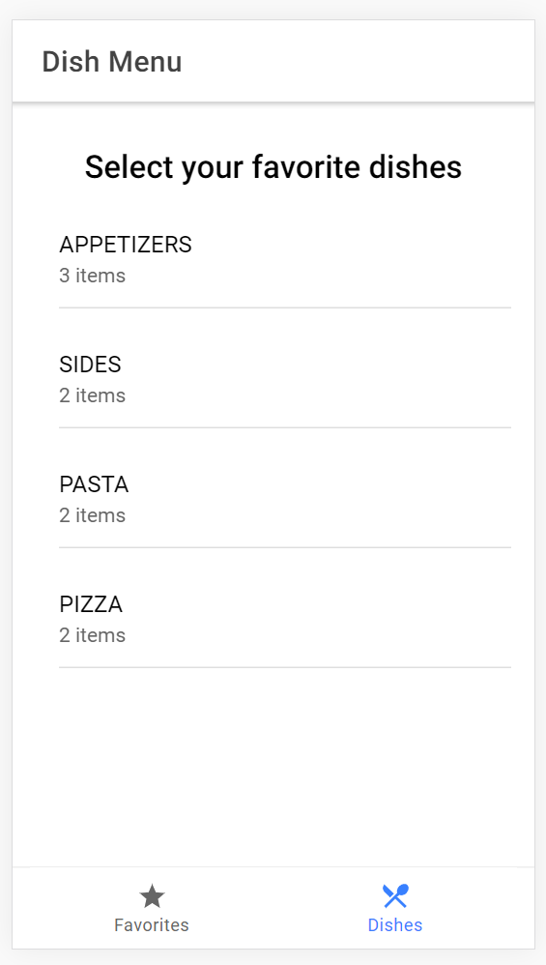
List Dish Categories on “tab2”
You will get the following dish category list in “Dishes” tab.

Slide 13
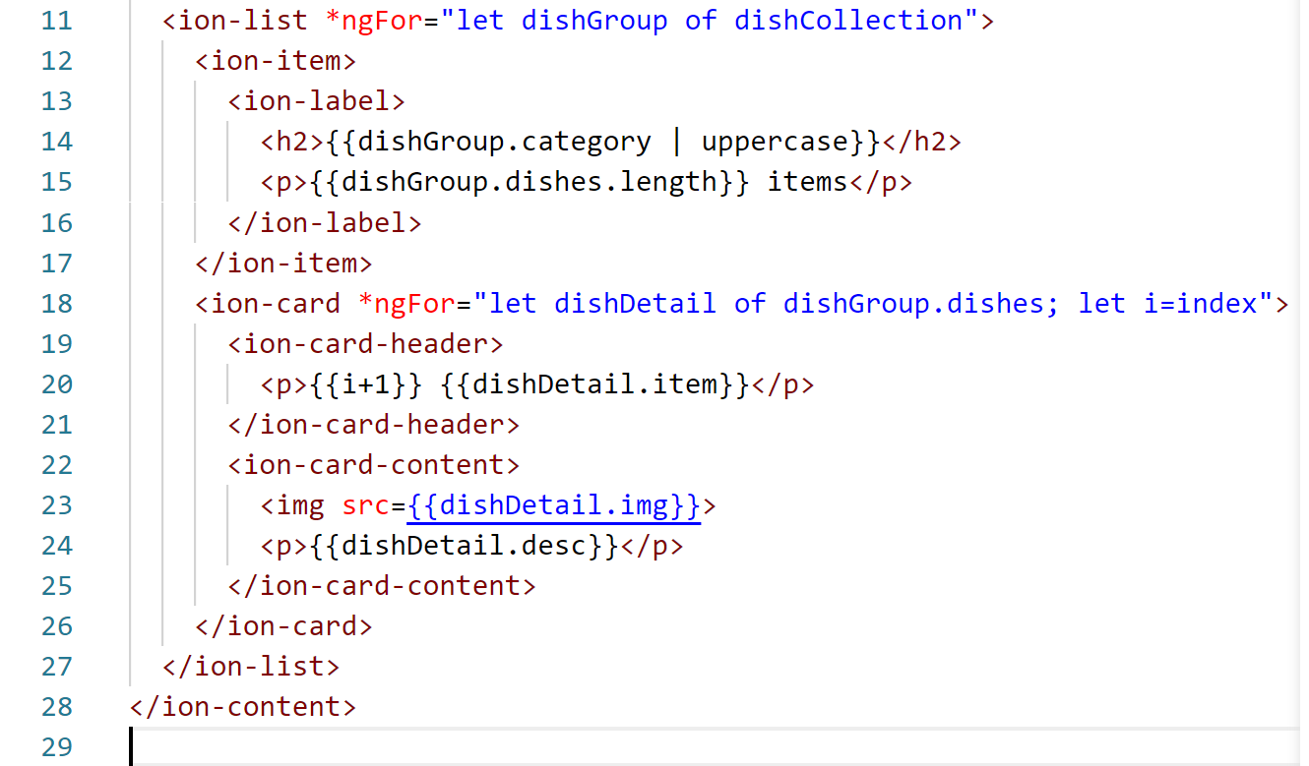
Use Card to Show Detail Information of Dishes
Edit “tab2.page.html” as follow to show dish information as a card

Slide 14
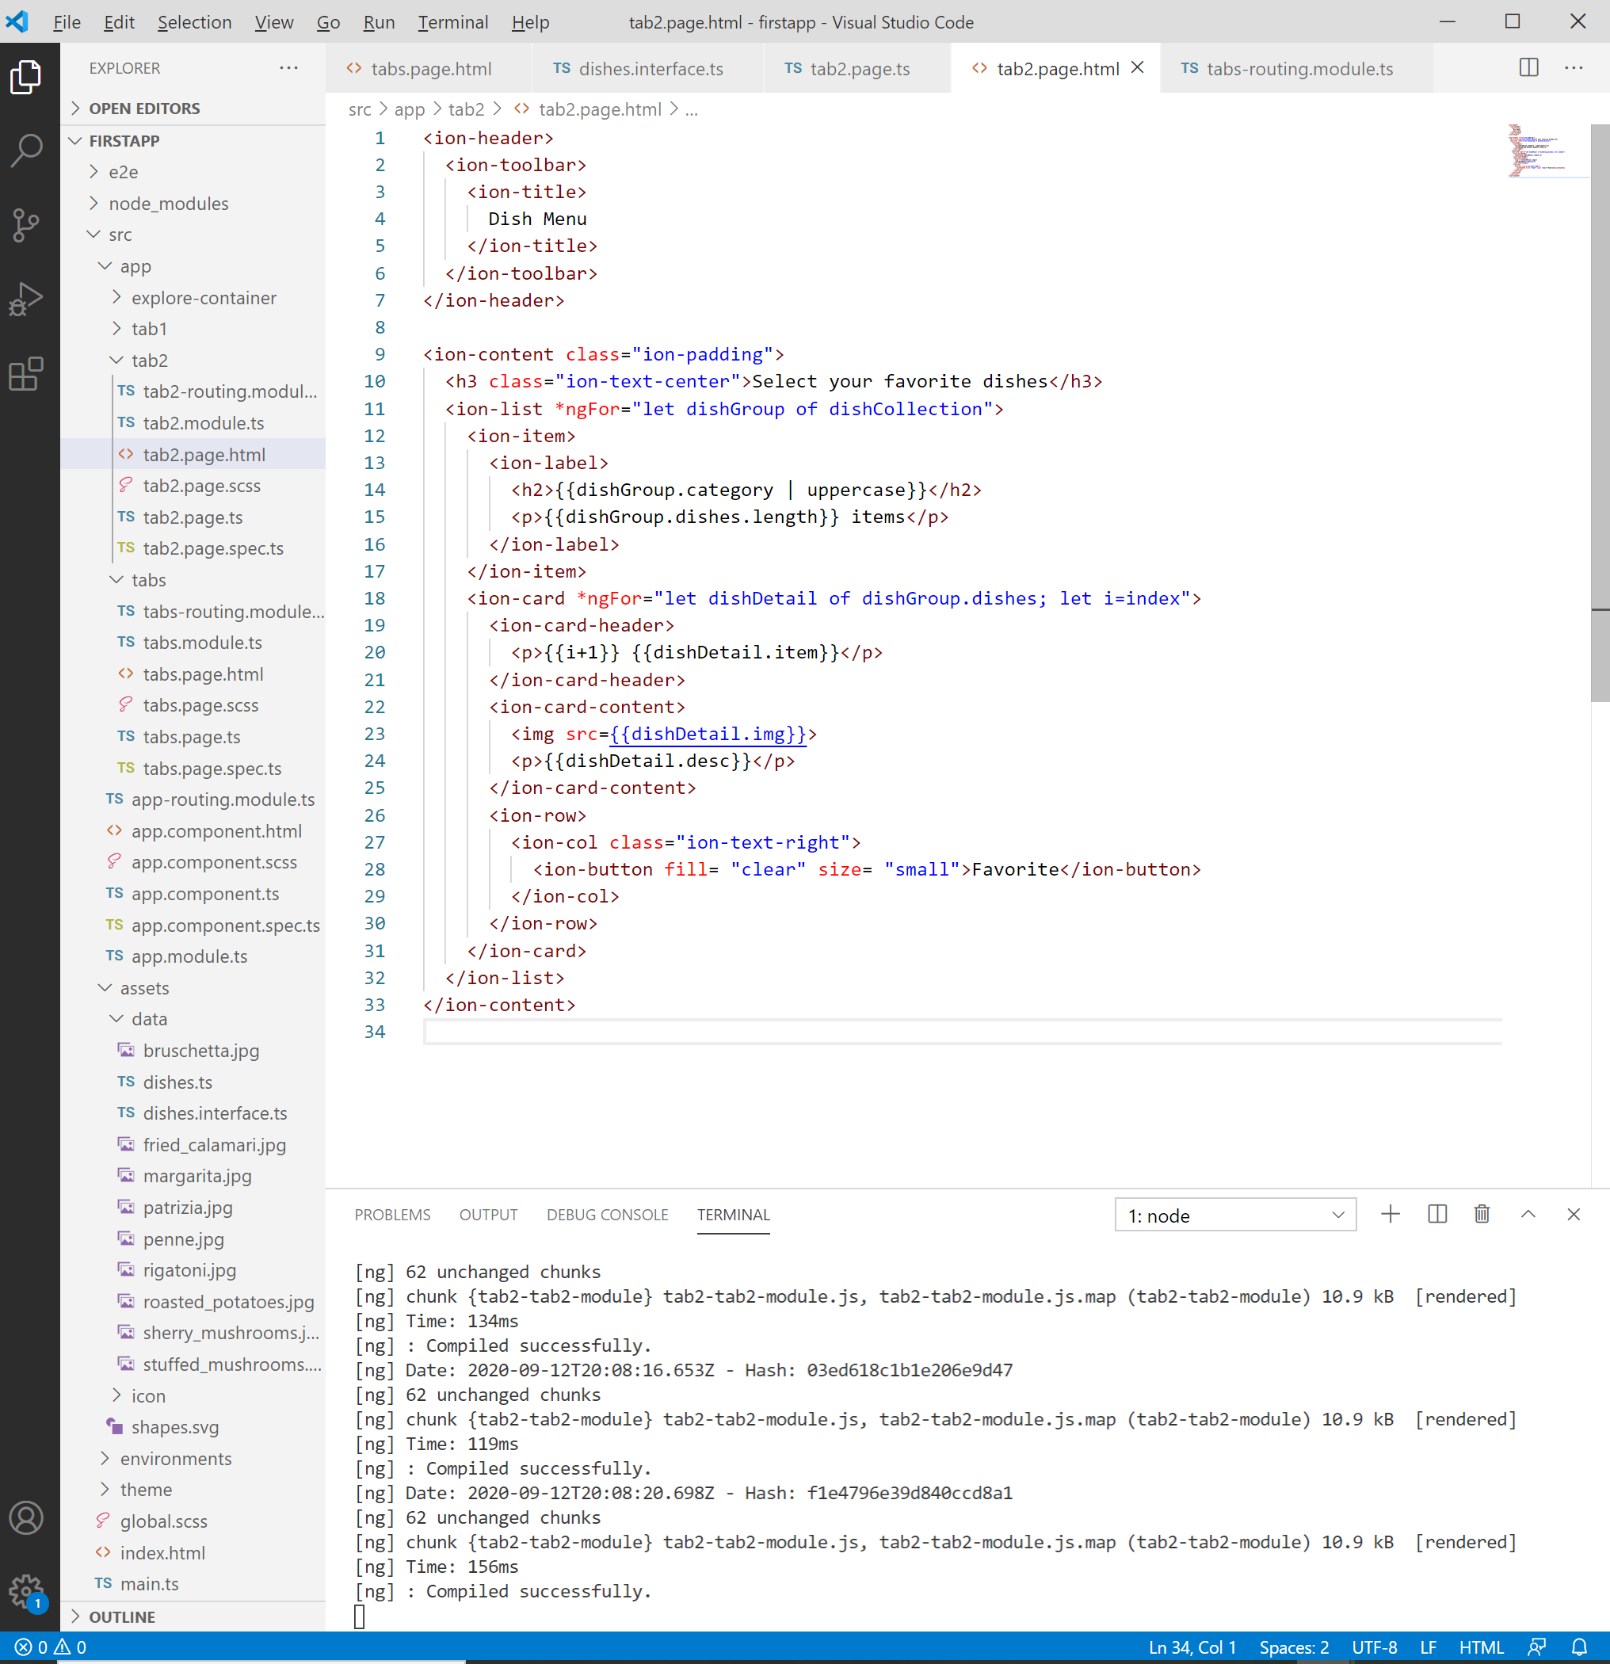
Use Card to Show Detail Information of Dishes
To add the “Favorite” Button to the card, edit “tab2.page.html” as follow

Slide 15
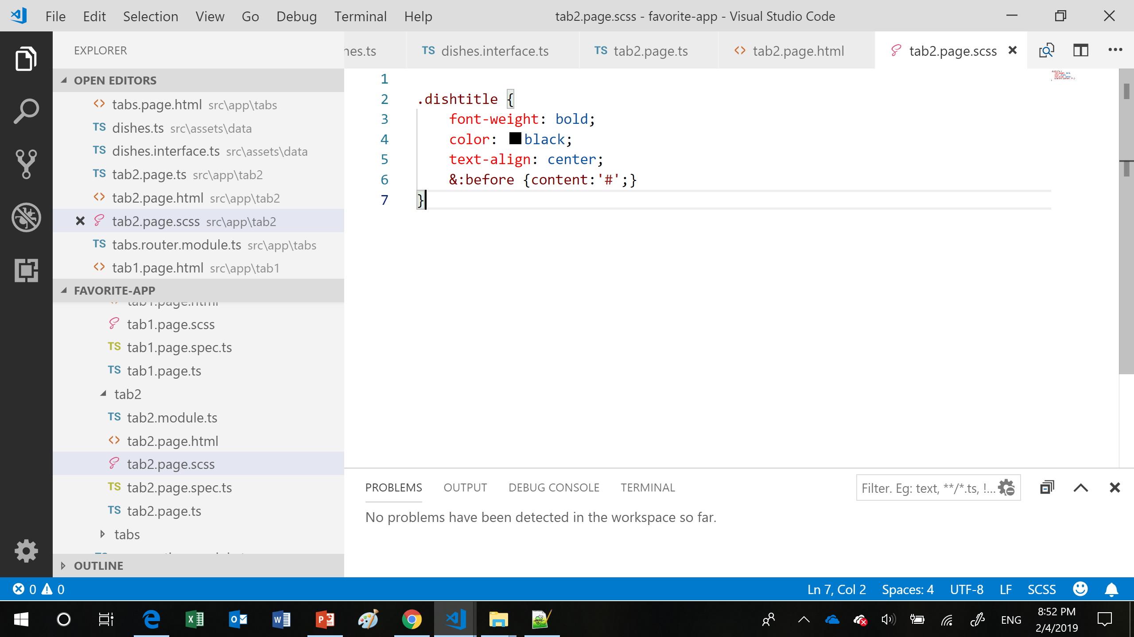
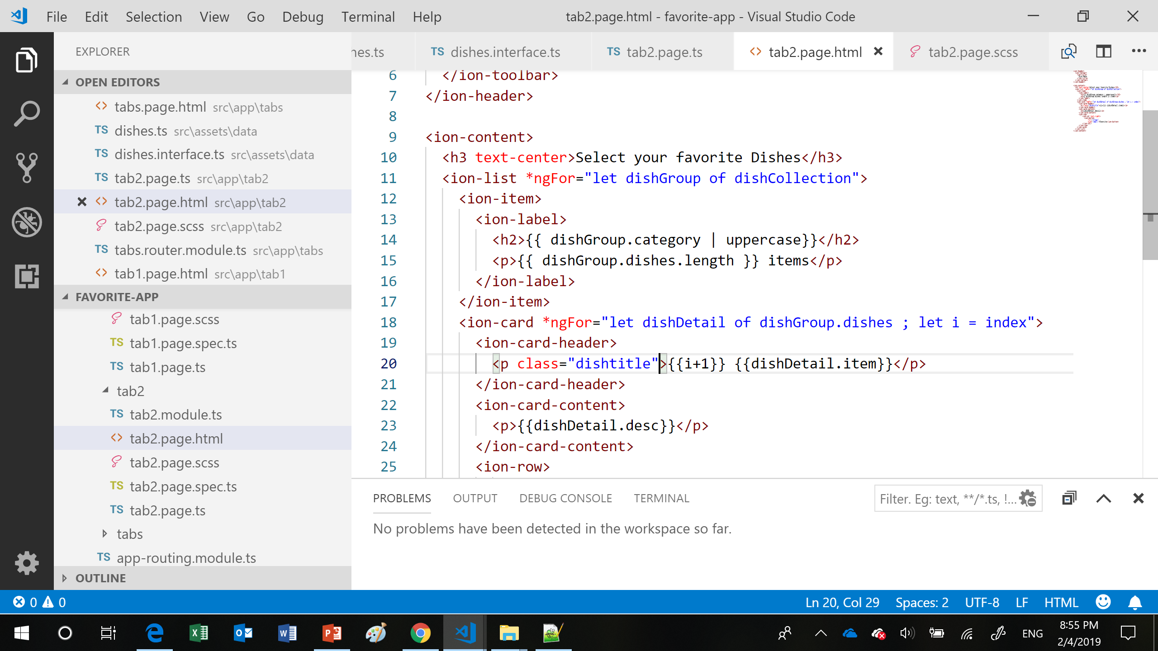
Use Card to Show Detail Information of Dishes
Edit “tab2.page.scss” as follow
Use “dishtitle” style in “tab2.page.html”

Slide 16
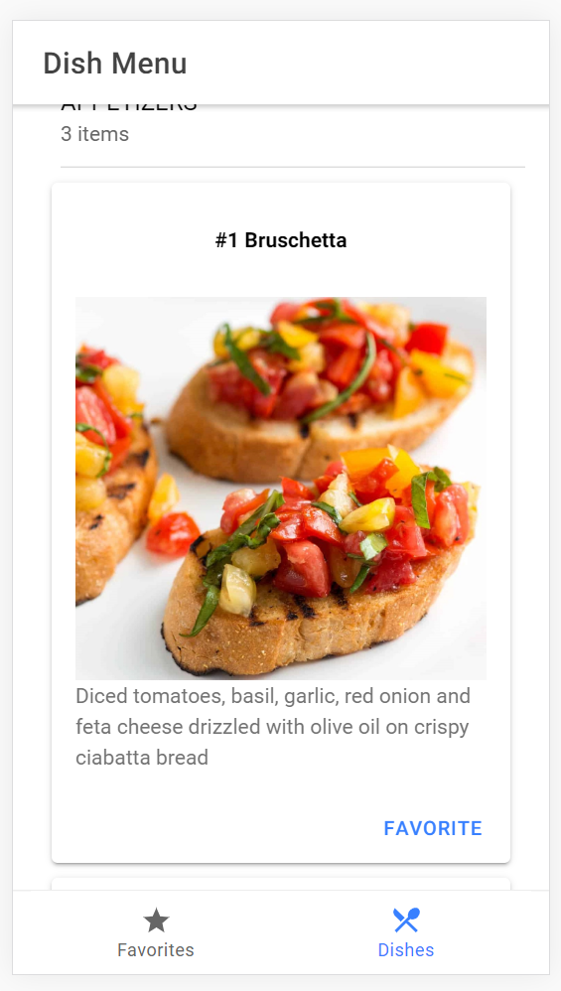
Use Card to Show Detail Information of Dishes
You will see the following dish cards in “Dishes” tab.

